Slide 1

Heart Disease Prediction
Yunsheng Li & Yung-Lin Chang
Predictive Analytics: Applications of Machine Learning
Nov. 21 2017

Slide 2
Menu
Motivation
Data Exploration and Preparation
Model Comparation
Feature Selection
Performance Improvement
Conclusion

Slide 3
Motivation
Using machine learning algorithm to explore the Heart Disease prediction
Comparing between different prediction models
Evaluating the attributes importance
THE GOAL is to CREATE a MEANINGFUL MODEL that we can
trust to answer whether the patient may have heart
disease or not.

Slide 4
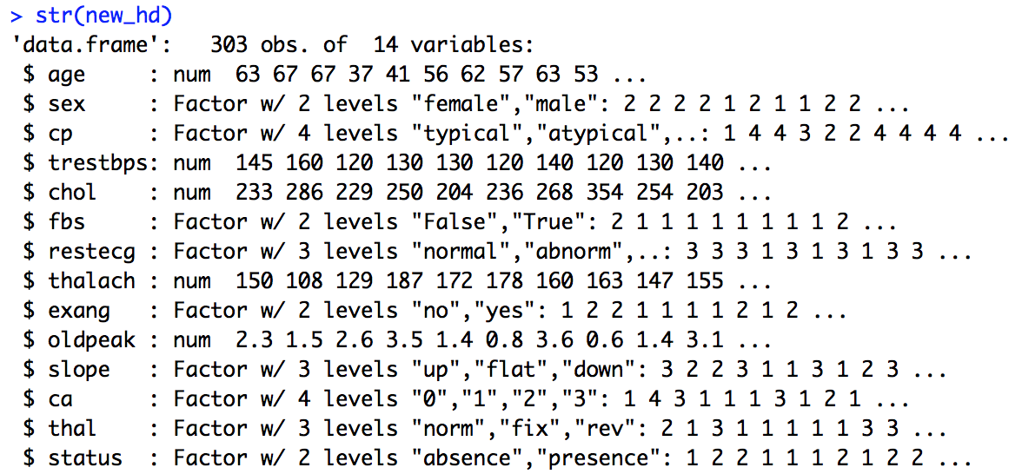
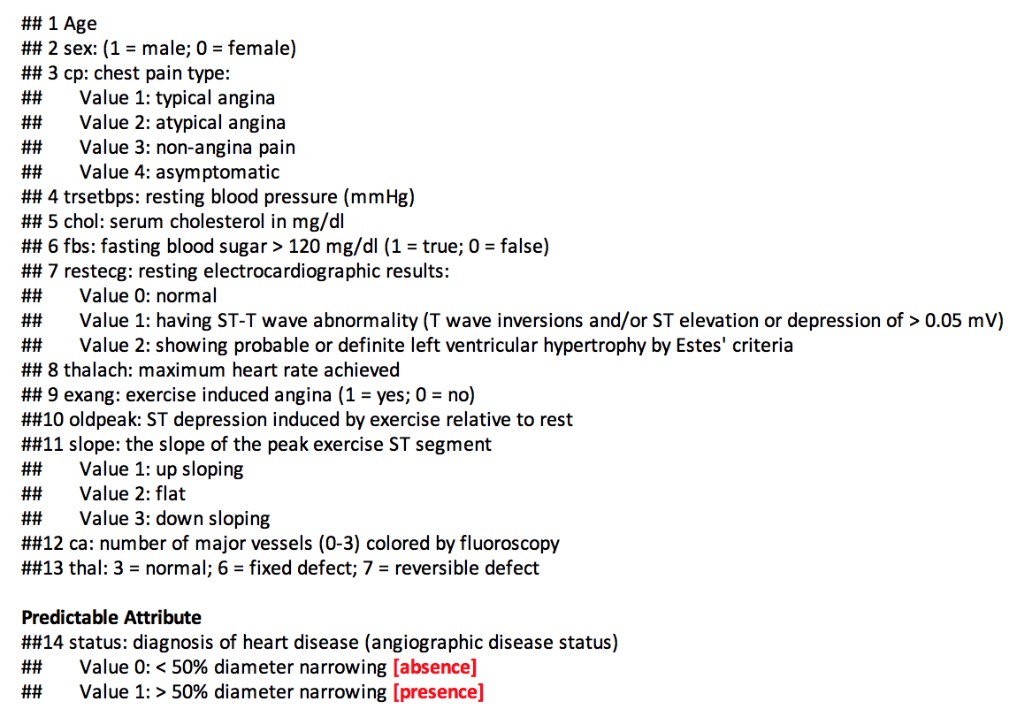
Data Preparation
The Dataset

Slide 5
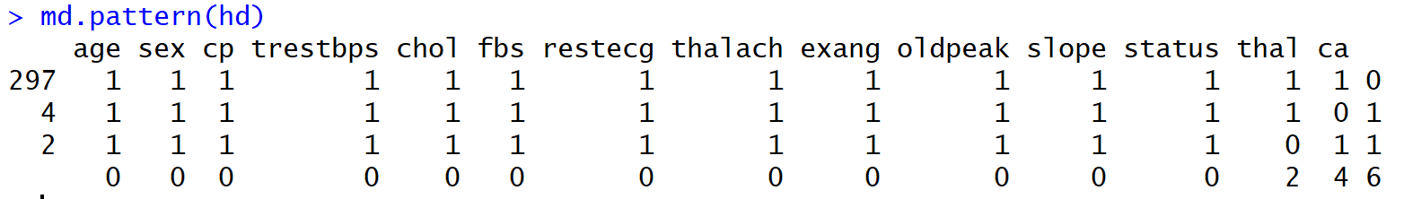
Data Preparation
Dealing with Missing Data by library mice
Figure out the missing data pattern

Slide 6
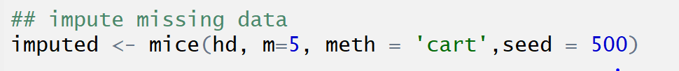
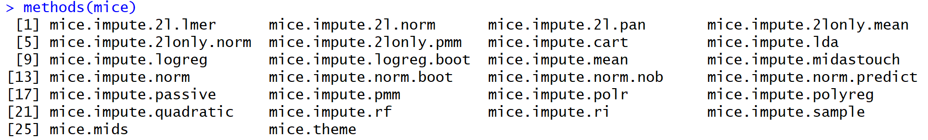
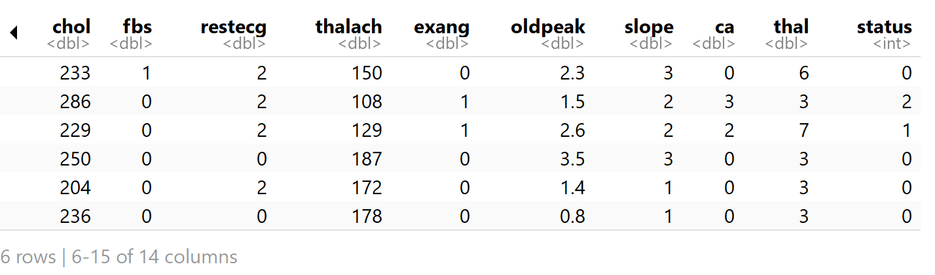
Data Preparation
Dealing with Missing Data by library mice
Imputes univariate missing data using classification and regression trees.
Chose one of the imputed data, complete the dataset.

Slide 7
Data Exploration
Unbalanced Response Variable
Use ROSE package to deal with binary classification problems .
Features: factors and numeric

Slide 8
Data Exploration
PCA is a statistical procedure that uses an orthogonal transformation to convert a set of observations of possibly correlated variables into a set of values of linearly uncorrelated variables called principal components.
--wikipeda
Principal Component Analysis(PCA)
Variance low, Be careful about feature selection.

Slide 9
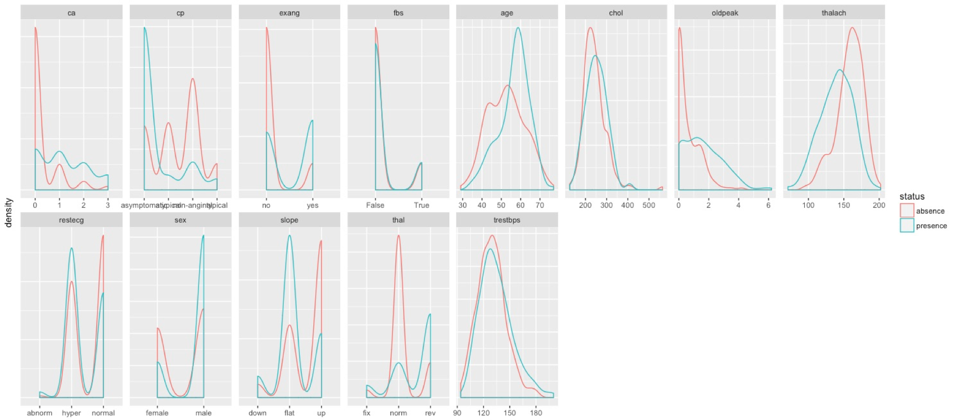
Data Exploration
Factors and numeric need pre-processing

Slide 10
Data Exploration
Scaled features with z-score

Slide 11
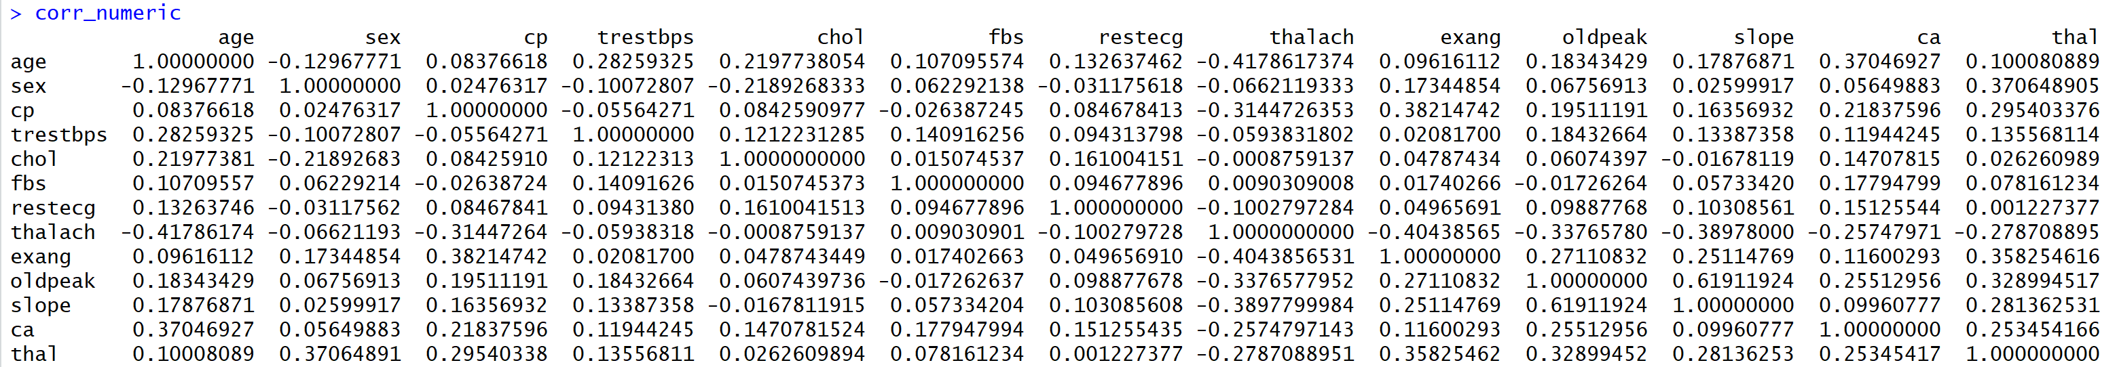
Data Exploration
Correlation
Compare row 10 and column 11 with corr 0.619 Means:
0.218 vs 0.154
so flagging column 10

Slide 12
Data Exploration
Labeled- supervised learning
Data scaled
Binary responsible variable
Classification- absence / presence

Slide 13
Model Comparation
Splitting data into training and test data, ideally stratified by response class
Density distribution

Slide 14
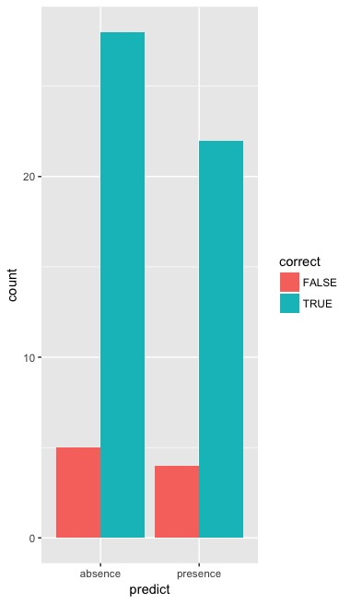
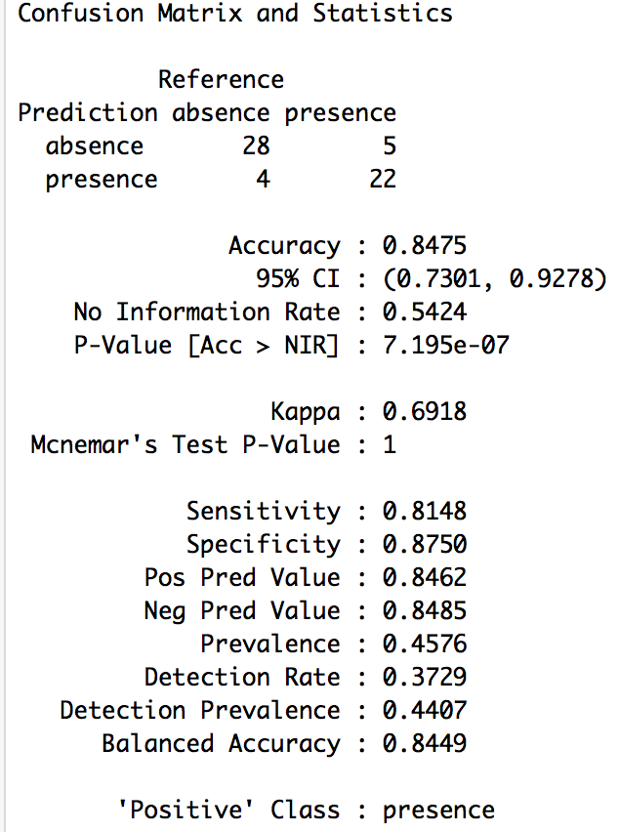
Model Comparation
Tree-based classification
With Decision Tree

Slide 15
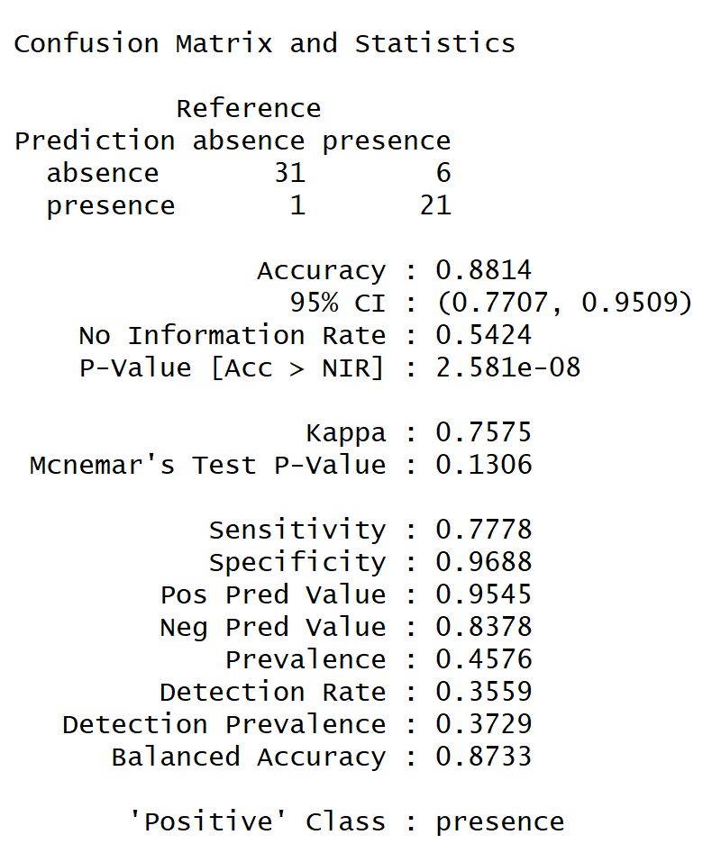
Model Comparation
Tree-based classification
With Random Forest

Slide 16
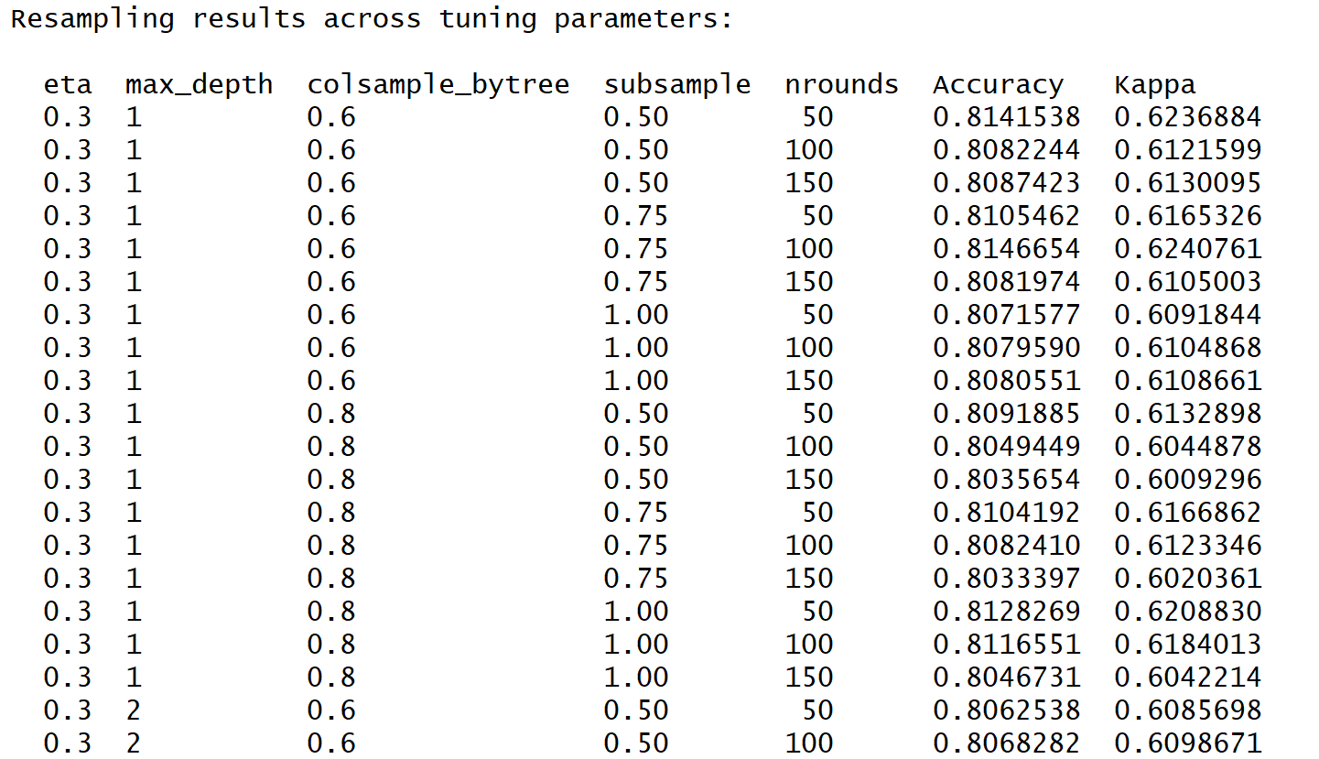
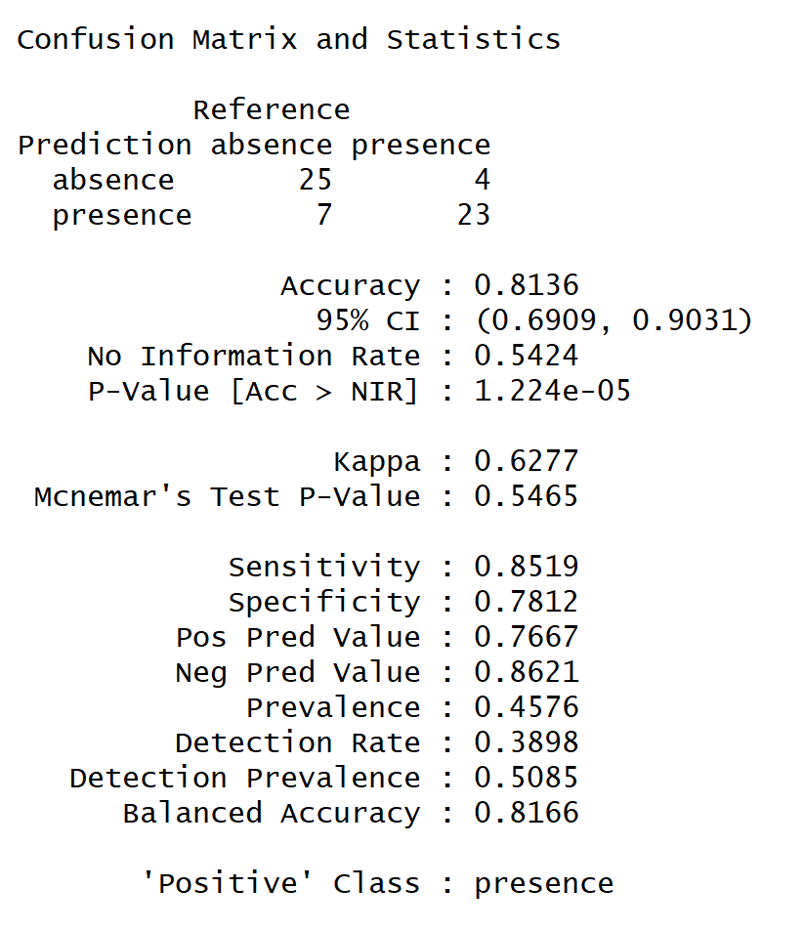
Model Comparation
“XGBoost uses a more regularized model formalization to control over-fitting, which gives it better performance.”
—— Tianqi Chen, developer of xgboost.
Tree-based classification
With Extreme gradient boosting trees

Slide 17
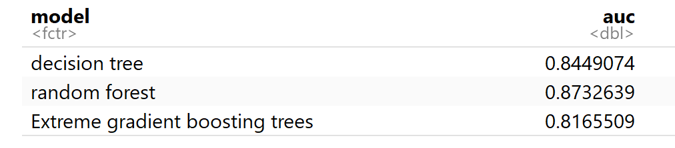
Model Evaluation
ROC Curve

Slide 18
Feature Selection
ca、cp、thal、exang
Decision Tree
Random Forest
XGBoost

Slide 19
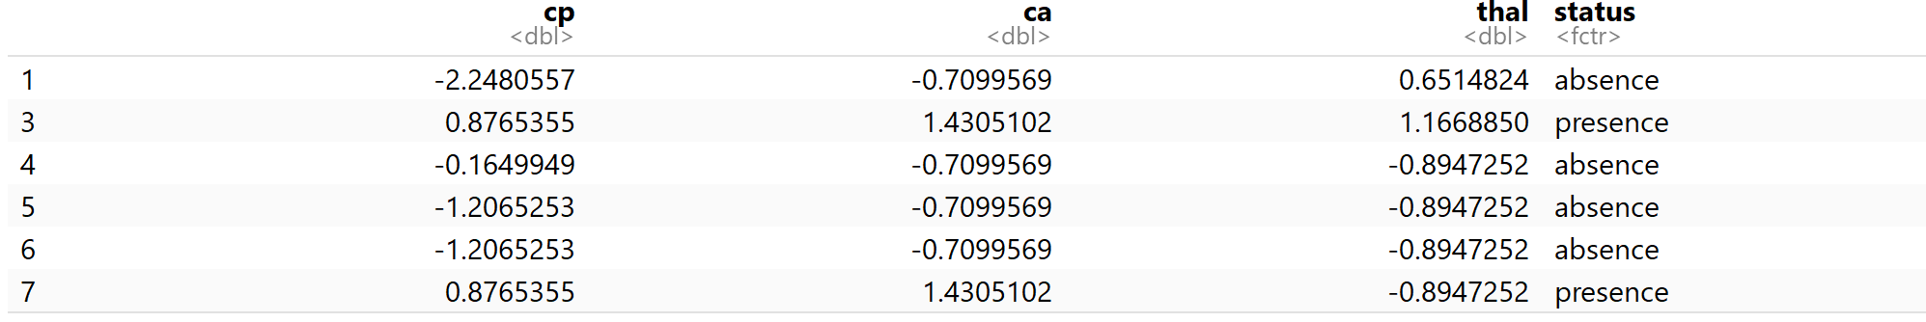
Feature Selection
ca、cp、thal
Recursive Feature Elimination
Another way to choose features is with Recursive Feature Elimination. RFE uses a Random Forest algorithm to test combinations of features and rate each with an accuracy score. The combination with the highest score is usually preferential.

Slide 20
Model Improvement
Prediction results

Slide 21
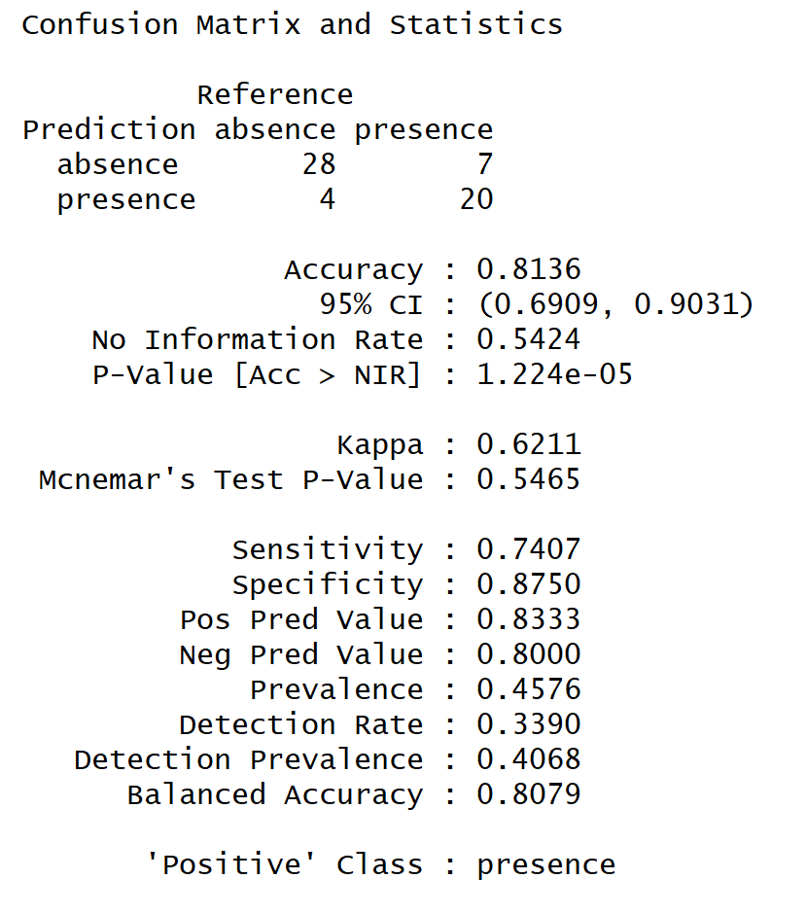
Model Improvement
Need more tuning

Slide 22
Conclusion
There is no “ONE-SIZE-FITS-ALL” approach to ML
Know your data well before modeling: missing data, variable type, visualizes the distribution of data…
Take time to think about pre-processing & feature selection
Testing different models and evaluating the effectiveness between them

